Slide 2
Managing Application Security

Slide 3
Managing Application Security
2.3 Summarize secure application development, deployment, and automation concepts
3.2 Given a scenario, implement host or application security solutions
2.6 Explain the security implications of embedded and specialized systems

Slide 4
2.3 Summarize secure application development, deployment & automation concepts
Software Diversity
Elasticity
Scalability
Software Development Life Cycle (SDLC) Models
Secure Coding Techniques
Open Web Application Security Project (OWASP)
Endpoint Protection

Slide 5
2.3 Summarize secure application development, deployment & automation concepts
Software Diversity
Developer can take code and obfuscate it with a compiler
Compiler takes code and converts it into binary machine language
Application Programming Interface (API) is created to allow systems to be programmed to talk to one another
Using a complier to obfuscate API methods will make it harder for attackers to reverse engineer the code.
Elasticity
Elasticity is the process of increasing resources when they are needed.
The cloud is a pay-as-you-go model where your resources can be increased at the drop of a hat
Scalability
This is where an application can take more users than originally planned with little or no increase in cost.

Slide 6

2.3 Summarize secure application development, deployment & automation Concepts
Software Development Life Cycle (SDLC)
Waterfall Development Model
Each stage is completed before the next stage commences
This is known as a cascade model
Requirements Gathering
System Design
Implementation
Testing
Maintenance

Slide 7
2.3 Summarize secure application development, deployment & automation Concepts
Software Development Life Cycle (SDLC)
Agile Model
Several stages of development can occur simultaneously
Software development approach based on iterative development with frequent testing
Development models entails several iterative and incremental software development methodologies such as Scrum
Break tasks into smaller iterations or parts
No long-term planning

Slide 8
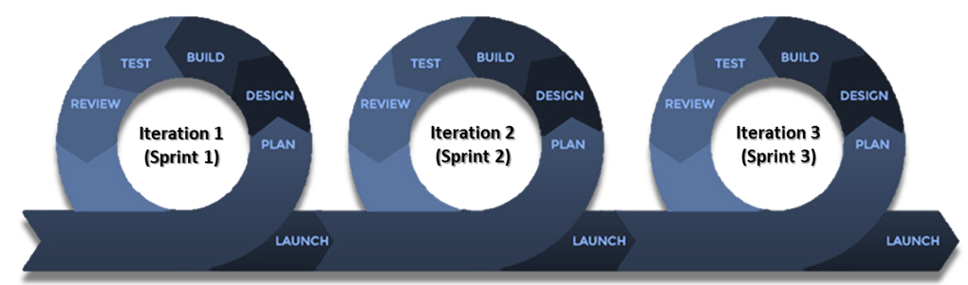
2.3 Summarize secure application development, deployment & automation Concepts
Software Development Life Cycle (SDLC)
Agile Development Methodology
Iteration 1
(Sprint 1)
Iteration 2
(Sprint 2)
Iteration 3
(Sprint 3)
Plan
Requirements gathering
Brainstorm
Requirements Analysis
Design
Design requirements
Document & prototype
Inception
Build
Development
Construction of iteration
Launch
Deployment
Post deployment feedback
Review
Iteration /Sprint review
Test
Testing
Quality Assurance
Iteration & feedback

Slide 9

Agile Development
Notes:
https://www.youtube.com/watch?v=gy1c4_YixCo&t=8s
https://www.scrum.org/resources/what-is-scrum/

Slide 10
2.3 Summarize secure application development, deployment & automation concepts
Software Development Life Cycle (SDLC)
SCRUM Methodology
Agile development process focused primarily on ways to manage tasks in team-based development conditions
Several stages of development can occur simultaneously
Team
Manages its work and organizes the work to complete the sprint or cycle
Scrum Master
Sets up the master team
arrange meetings (daily scrum)
Remove obstacles from the process
Product Owner
Makes the product backlog
Prioritizes the delay

Slide 11
2.3 Summarize secure application development, deployment & automation Concepts
Secure Deployments
Development
Secure environment
Writing code
Developers test in their sandboxes
Test
Still in the development stage
All of the pieces are put together
Functional tests
Development
Test
Staging
Production

Slide 12
2.3 Summarize secure application development, deployment & automation concepts
Testing
Manual Code Review
Developer reads code line by line to ensure code is written properly with no errors
Static Code Analysis
Code is not executed locally
Source code is run inside static code analyzer tool that reports any flaws or weaknesses
Dynamic Code Analysis
When developers use dynamic analysis, the code is actually being executed (locally)
Random input is inserted into the application to see what the output will be
Regression Testing
Dynamic analysis used to evaluate a program for security flaws
Uses the technique called fuzzing and a tool called a fuzzer
Malware discovered by application fuzzing includes backdoors

Slide 13
2.3 Summarize secure application development, deployment & automation Concepts
Secure Deployments
Sandboxing
Deployment concept that can be used to ensure only the required OS access is exposed to software applications
Used to run an untested application
Restricts the access of the software to a contained logical space and limits possible damage
Reduce the risk from an unknown vulnerability in a third-party Software

Slide 14
2.3 Summarize secure application development, deployment & automation Concepts
Secure Deployments
Staging
Almost ready to roll it out
Works and feels exactly like the production environment
Working with a copy of production data
Run performance tests
Test usability and features
Production
Application is live
Rolled out to the user community
Development
Test
Staging
Production

Slide 15
2.3 Summarize secure application development, deployment & automation Concepts
Secure Deployments
Quality Assurance
Ensures the application is ready to be released to production
Verifies features are working as expected
Validates new functionality
Verifies old errors don’t reappear
Version control
Change management for software development
Tracked by using version numbers
Track those changes, revert back to a previous version
Useful for security
Compare versions over time
Identify modifications to important files

Slide 16
2.3 Summarize secure application development, deployment & automation Concepts
Secure Deployments
Secure baselines
The security of an application environment should be well defined
All application instances must follow this baseline
Firewall settings, patch levels, OS file versions
May require constant updates
Integrity measurements
Object that utilizes the trusted platform module to compute a hash of system files and compare the value to a known-good value
Check for the secure baseline
Check against well-documented baselines
Failure requires an immediate correction

Slide 17


2.3 Summarize secure application development, deployment & automation concepts
Secure Coding Techniques
Two of the most popular open-source web stack solutions are MEAN and LAMP
They incorporate different backend technologies, database solutions, and server environments
MEAN includes a front end component, whereas LAMP refers to just the back end
Linux (OS) | MongoDB (NoSQL database)
Apache (Web Server) | Express.js (Server-Side Framework on top of Node.js)
MySQL (Database Management System) | Angular (Client-Side Framework)
PHP, Perl, or Python (Programming Language) | Node.js (JavaScript Runtime Environment)

Slide 18
2.3 Summarize secure application development, deployment & automation Concepts
Provisioning and Deprovisioning
Application provisioning is the life cycle of
Designing the applications
Preparing the applications
Creating the applications
Managing the applications
Ensuring no flaws in the application before release
Application Deprovisioning
Application meets its end of life
Remove the application
Migrate the data to the new system
Dispose of it

Slide 19
2.3 Summarize secure application development, deployment & automation Concepts
Secure Coding Techniques
Dead code
Code that is never executed
Consumes resources
Should be removed as it serves no purpose
Code reuse
Use old code to build new applications
Security vulnerabilities in old code spreads it to other applications

Slide 20
2.3 Summarize secure application development, deployment & automation Concepts
Secure Coding Techniques
Software Diversity
Software-Developer Kits (SDKs)
limit the amount of data allocated to a user who is using an application
Use input validation and DLP to protect our data
Code Obfuscation
Used to make the source code look obscure
If it is stolen it cannot be understood
Developer can take code and obfuscate it with a compiler
Cannot reverse engineer the code to find vulnerabilities
Compiler takes code and converts it into binary machine language
Examples on next slide

Slide 21
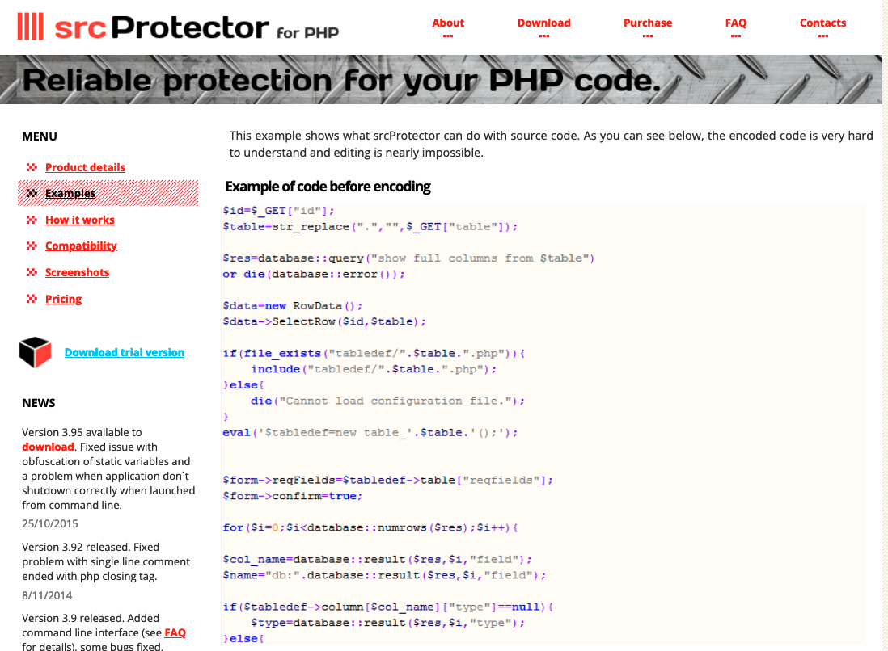
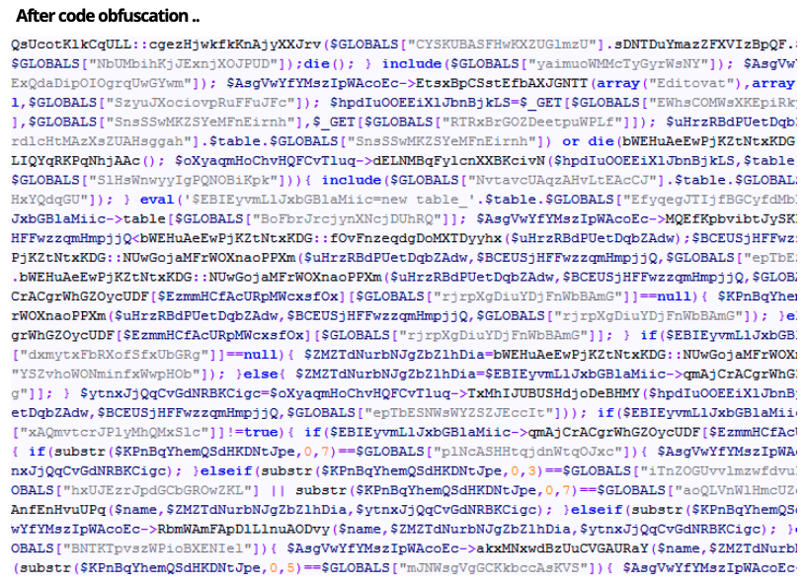
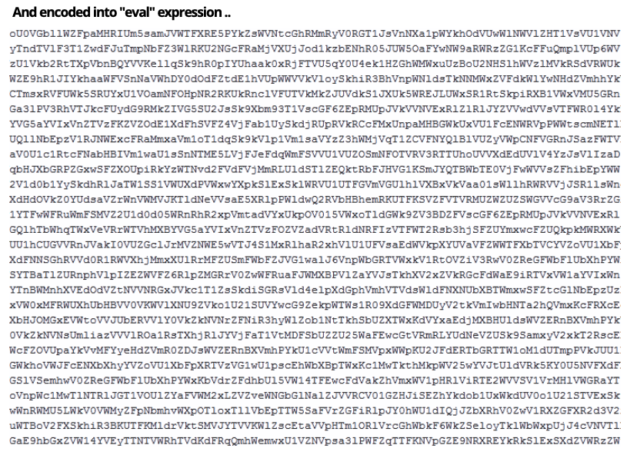
Code Obfuscation
Notes:
Example of code obfuscation

Slide 22
2.3 Summarize secure application development, deployment & automation Concepts
Automation and Scripting
Continuous Integration
Code from multiple sources is integrated together
Continuous Validation
Automatically validate a configuration before going live
Perform ongoing automated checks
Continuous Delivery
Fixing bugs before the application moves into production
Happens in the staging environment
Continuous Deployment
Pushing out new updates into production software
Patching
Continuous Monitoring
Log any failures by the application so steps can be taken to remedy them

Slide 23
2.3 Summarize secure application development, deployment & automation concepts
Open Web Application Security Project (OWASP)
Provides an up-to-date list of the Top 10 web application security risk
2017
2021
A01:2017-Injection
A01:2021-Broken Access Control
A02:2017-Broken Authentication
A02:2021-Cryptographic Failures
A03:2017-Sensitive Data Exposure
A03:2021-Injection
A04:2017-XML External Entities
A04:2021-Insecure Design (New)
A05:2017-Broken Access Control
A05:2021-Security Misconfiguration
A06:2017-Security Misconfigurations
A06:2021-Vulnerable and Outdated Components
A07:2017-Cross-Site Scripting
A07:2021-Identification and Authentication Failures
A08:2017-Insecure Deserialization
A08:2021-Software and Data Integrity Failures (New)
A09:2017-Using Components with Known Vulnerabilities
A09:2021-Security Logging and Monitoring Failures
A10:2017-Insufficient Logging & Monitoring
A10:2021-Server-Side Request Forgery (New)

Slide 24

QUESTIONS

Slide 25
Endpoint Protection

Slide 26
3.2 Given a scenario, implement host or application security solutions
Endpoint protection
Antivirus/Antimalware
Ensure that all servers and desktops are protected and up to date
Endpoint Detection and Response (EDR):
Advanced solution that is better than anti-virus or anti-malware
Best suited for the detection and prevention of
Malware
Code executions
Buffer overflows
Privilege Escalation
Lateral movement
Ransomware

Slide 27
3.2 Given a scenario, implement host or application security solutions
Endpoint protection
Host-Based Firewall
A host-based firewall can be used to:
Prevent unauthorized access to the desktop
Allow anti-virus updates
VPN
DNS name resolution
Controlling incoming traffic
Set up permitted rules for approved applications
2017—08-21 10:48:12 DROP TCP 172.20.89.232 239.255.255.255 443 1900 250 --------RECEIVE 2017—08-21 10:48:12 DROP UDP 192.168.72.205 239.255.255.255 443 1900 250 --------RECEIVE

Slide 28
3.2 Given a scenario, implement host or application security solutions
Endpoint protection
Host Intrusion Detection System (HIDS)
Function is to alert the user to any discrepancies or attacks (Passive response)
Uses a database that contains the settings for the computer
Registry
Critical system files
Applications
Components
Host Intrusion Prevention System (HIPS)
Analyzes the behavior of a computer
Looks for any suspicious behavior in log files and memory
Takes the appropriate action to prevent attacks
Active response

Slide 29
3.2 Given a scenario, implement host or application security solutions
Hardening
Registry
The registry is a database of all the settings on your computer, and gaining access to the registry can allow someone to cause damage to the computer
If you make a change in control, that change is reflected in your registry
You can access the registry by using the regedit command: HKEY_

Slide 30
3.2 Given a scenario, implement host or application security solutions
Boot Integrity
UEFI (Unified Extensible Firmware Interface)
Modern version of the BIOS and is needed for secure boot
Measured Boot
Logs information about the firmware and application and stores this log in the TPM chips
Used to check for:
Health status
Anti-malware
Trustworthy software
Boot attestation
Checks the integrity of the software as it is being loaded

Slide 31
3.2 Given a scenario, implement host or application security solutions
Application Hardening
Full Disk Encryption (FDE)
Software drive encryption
Trusted Platform Module (TPM)
TPM chips are normally built into the motherboard of a computer and
Used when you are using Full Disk Encryption (FDE)
Example of FDE would be Bitlocker
Hardware Root of Trust
Use certificates for FDE, you use a hardware root of trust
Verifies that the keys match before secure boot process

Slide 32
3.2 Given a scenario, implement host or application security solutions
Application Hardening
Self Encrypting Drive (SED)
Hardware drive encryption
SEDs are Solid State Drives (SSDs)
Set to encrypt data at rest
Encryption keys are stored on the hard drive controller
Protects laptop hard drives against loss or data theft
Hardware Security Module (HSM)
Removable device attached to a computer or server via a USB connection
Used to store encryption keys
Key escrow holds private keys of third parties and stores them in an HSM

Slide 33
3.2 Given a scenario, implement host or application security solutions
Application Security
HTTP Strict Transport Security (HSTS)
HSTS will ignore all HTTP connections
Ensures that the web browser only accepts secure connections and prevents XSS
Secure Cookies
Cookies are used by web browsers and contain information about your session
Can be stolen by attackers to carry out a session hijacking attack.
Set the secure flag on the website to ensure that cookies are only downloaded when there is a secure HTTPS session

Slide 34
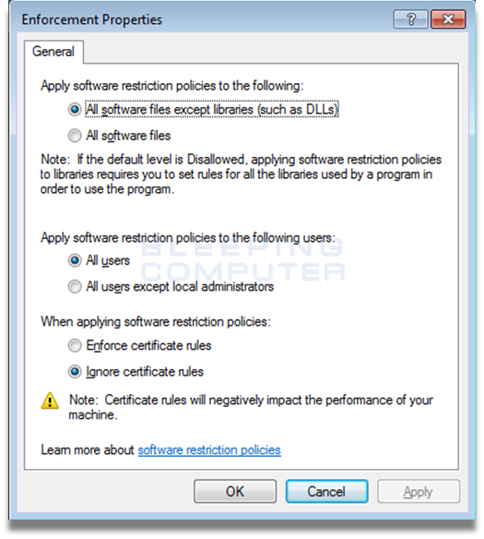
3.2 Given a scenario, implement host or application security solutions
Application Security
Whitelisting and Blacklisting can be configured to allow or deny executable files and software applications.
Misconfigurations can inadvertently prevent an application from running
To minimizing risk and attack exposure
Whitelist the affected libraries for applications required by users
Execute permission denied: financemodule.dll
Execute permission denied: generalledger.dll

Slide 35
3.2 Given a scenario, implement host or application security solutions
Application Hardening
Patch Management
Ensure that systems are up-to-date
Protects system against known vulnerabilities
Test patches in a test environment that mirrors the production environment
Automated deployment
Testing, deploying and verifying updates
Change Management
Helps ensure changes to IT systems do not result in unintended outages
Provides an accounting structure or method to document all changes
Changes are proposed and reviewed before implementation

Slide 36
3.2 Given a scenario, implement host or application security solutions
Endpoint protection
Data Loss Prevention (DLP)
Can protect data on your computer from being stolen by using
Email
USB drive
Unauthorized remote access
Protect any data that has a pattern match
PII information
PHI information
Sensitive data

Slide 37
2.6 Explain the security implications of embedded and specialized systems
Supervisory Control & Data Acquisition (SCADA)
Industrial Control System (ICS)
Internet of Things (IoT)
Real-time operating system (RTOS)
Multifunctional Devices (MFDs)

Slide 38
2.6 Explain the security implications of embedded and specialized systems
Supervisory Control & Data Acquisition
SCADA systems are automated control systems that can be used where there are multiple phases of production
Water Pumps
Refineries
Industrial and manufacturing facilities
A malicious actor compromised the SCADA Supervisory Systems after a water utility company has seen a dramatic increase in the number of water pumps burning out.
SCADA Supervisory Systems, if compromised, may cause great danger to the integrity of water supplies and their chemical levels.
Configuring the SCADA Supervisory Systems to ensure only necessary applications are able to run maximizes the protection of these systems from malicious software.

Slide 39



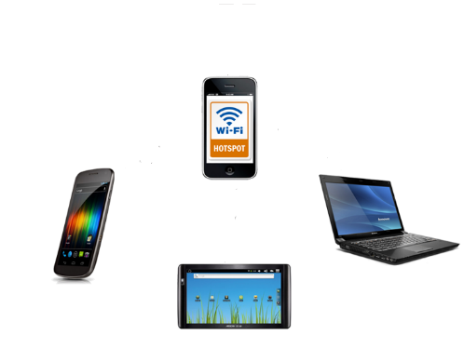

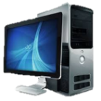
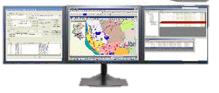




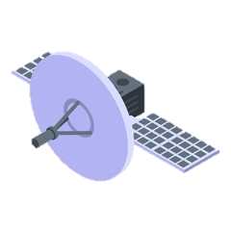
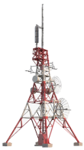


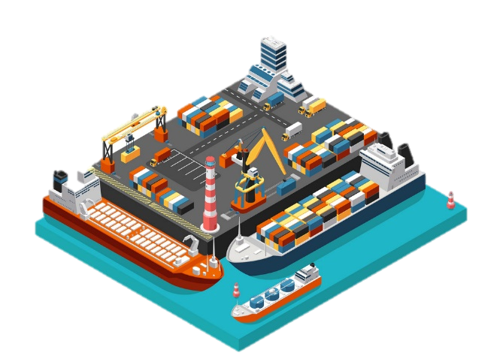
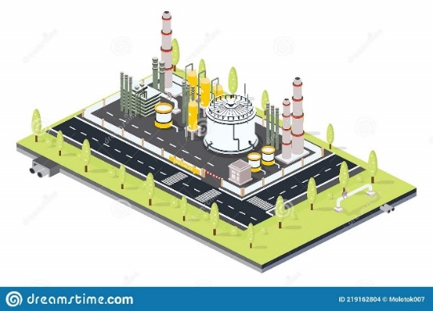
SCADA Network
Supervisory Control & Data Acquisition (SCADA)
Operator
Workstation
Corporate Office
Firewall
Engineer
Workstation
Database Server
Router
Ensure only necessary applications are able to run
RTU
RTU
RTU
Remote Station 1
Remote Station 2
Remote Station 3
39

Slide 40
2.6 Explain the security implications of embedded and specialized systems
Industrial Control System (ICS)
Controlled by a SCADA
Used for industrial process control
Telecommunications
Health, chemicals and
Pharmaceuticals
Water supply and treatment
Safety controls are in place to control processes

Slide 41
2.6 Explain the security implications of embedded and specialized systems
Internet of Things (IoT)
IoT comprises small devices, such as:
Sensors
Smart Devices
Wearable Technology
Home Automation
Facility automation

Slide 42
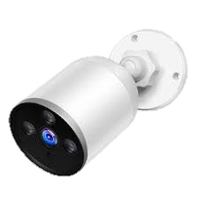

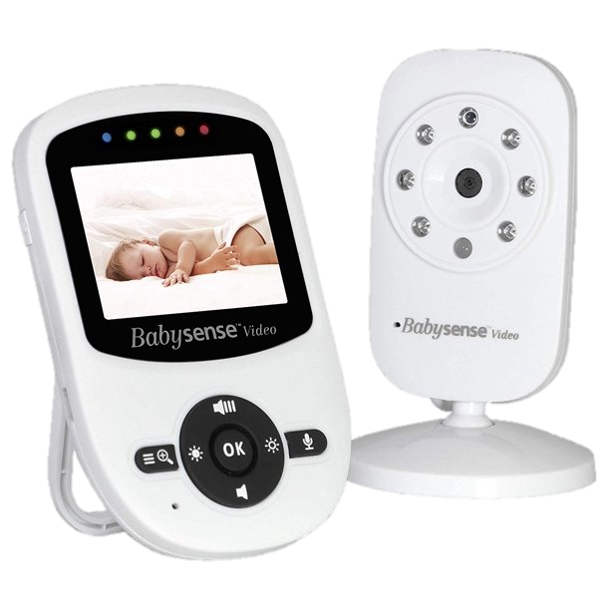


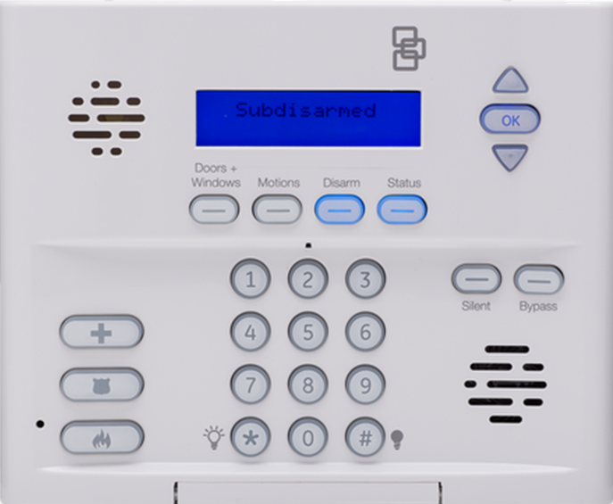

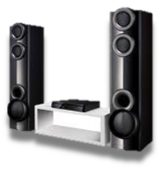
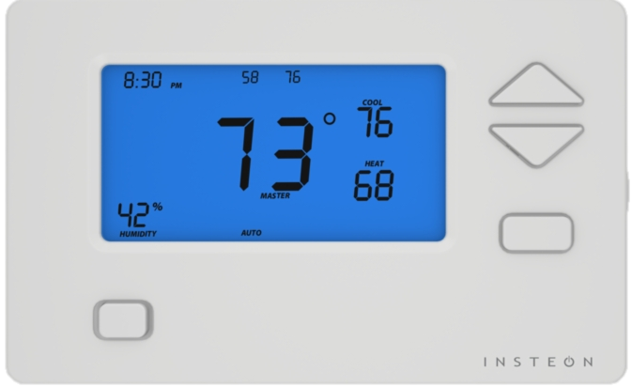
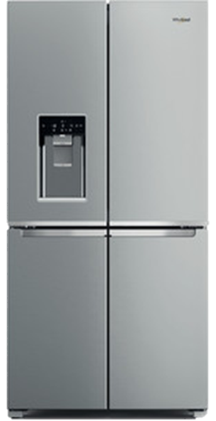

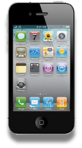
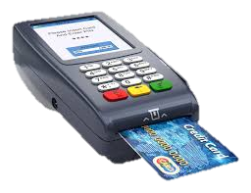

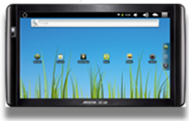
2.6 Explain the security implications of embedded and specialized systems
Internet of Things (IoT)
Security Camera
Smart Bulb
Automobile
Baby Monitor
Home Automation
Smart Watch
Alarm System
Speakers
Thermostat (HVAC)
Credit Card Reader
Refrigerator
Printer
Smart Phone
Laptop
Tablet

Slide 43
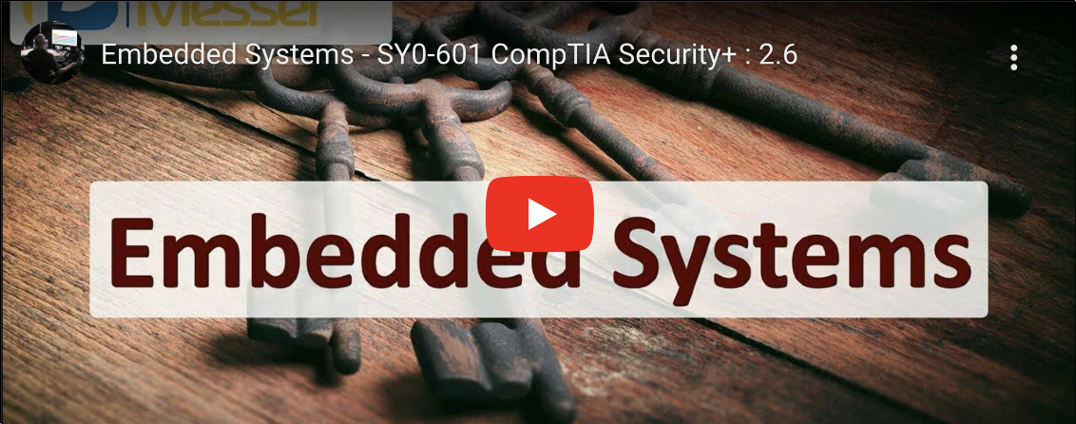
Professor Messer: Embedded Systems
Notes:
https://youtu.be/guPeDcG2WiI

Slide 44
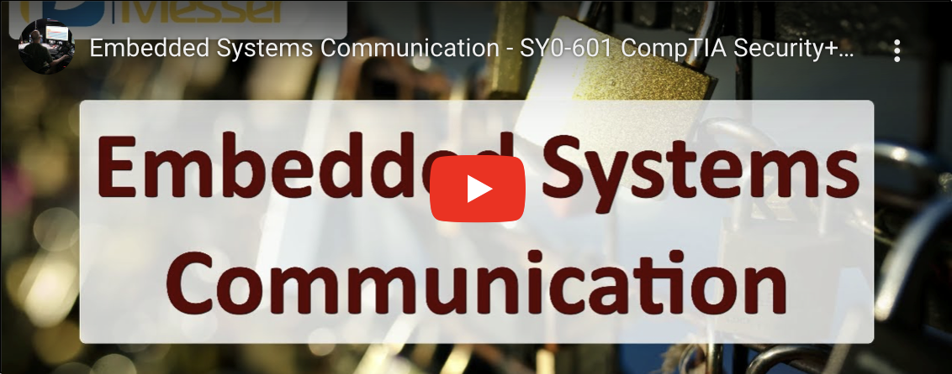
Professor Messer: Embedded Systems Communications
Notes:
https://youtu.be/rVirqAVXB3U

Slide 45
Embedded Systems
Computer system with dedicated function
Static environment
Cost, power, and compute constraints
Single-purpose devices with no overhead for additional security computing
Crypto, authentication, and implied trust constraints
Limited resource for cryptographic implementation
No root of trust
Perimeter security
Network and range constraints
Power constrains range
Emphasize low data rates, but minimize latency

Slide 46
2.6 Explain the security implications of embedded and specialized systems
Internet of Things (IoT)
Most users of IoT devices are not aware that they have default username and passwords, and are vulnerable to attack
Built-in accounts that users rarely access is a security consideration for IoT devices
When considering IoT systems, tight integration to existing systems represents the GREATEST ongoing risk after a vulnerability has been discovered
Apply firmware and software updates upon availability is the BEST way for home users to mitigate vulnerabilities associated with IoT devices on their home networks

Slide 47
2.6 Explain the security implications of embedded and specialized systems
Internet of Things (IoT)
Communication Protocols
When implementing automation with IoT devices Communication protocols should be considered FIRST to keep the network secure
Z-Wave & Zigbee
Low-power wireless over ~900 MHz and 2.4 GHz
Encryption and pairing

Slide 48
2.6 Explain the security implications of embedded and specialized systems
Real-time operating system (RTOS)
RTOS could be used where robots are being used in production to ensure that processes are completed quickly.
Designed to be ultra-stable
Prioritizes real-time scheduling
If a task or process does not complete within a certain time, the process will fail

Slide 49
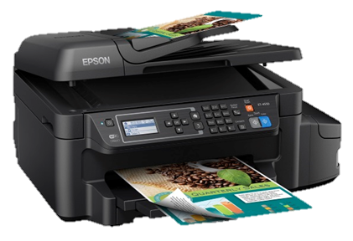
2.6 Explain the security implications of embedded and specialized systems
Multifunctional Devices (MFDs)
All-in-one device consisting of at least two of the following
Printer
Scanner
Fax
Photocopier
Network interface components of printers and MFDs are the MOST likely used as vectors of compromise if they are improperly configured
Notes:
In 2014, security researchers hacked the web interface of a Canon Pixma printer and used the exploit to install the 1990s first-person shooter game Doom on the printer firmware (wired.com/2014/09/doom-printer).

Slide 50
Specialized Systems for Vehicles and Drones
Unmanned Aerial Vehicles (UAV)/drones
Computer-controlled or assisted engine, steering, and brakes
In-vehicle entertainment and navigation
Controller area network (CAN) serial communications buses
Onboard Diagnostics (OBD-II) module
Access via cellular or Wi-Fi

Slide 51
Specialized Systems for Medical Devices
Used in hospitals and clinics but also at home by patients
Potentially unsecure protocols and control systems
Use compromised devices to pivot to networks
Stealing Protected Health Information (PHI)
Ransom by threatening to disrupt services
Kill or injure patients

Slide 52
Security for Embedded Systems
Network segmentation
Strictly restrict access to OT networks
Increased monitoring for SCADA hosts
Wrappers
Use IPSec for authentication and integrity and confidentiality
Firmware code control
Supply chain risks
Inability to patch
Inadequate vendor support
Time-consuming patch procedures
Inability to schedule downtime

Slide 53
Answer the Questions…
To develop secure software that prevents attackers from directly injecting attacks into computer memory and manipulating the application’s process, one should employ
Elasticity
Dead code
Normalization
Software diversity
Problems in which phase will specifically stop continuous deployment but not necessarily continuous delivery
Continuous integration
Continuous monitoring
Continuous validation
Continuous development
Which of the following properly defines supervisory control and data acquisition (SCADA)?
A scaled-down version of Linux designed for use in an embedded system
The standard used for communicating between intelligent car systems
The risk created y connecting control systems in buildings
A systems designed to control automated systems in cyber-physical environments
Notes:
Answers
d (Software diversity in the form of diverse binaries will prevent direct memory attacks against known software structures.)
c (Continuous validation is required to ensure error-free software, and errors will stop continuous development.)
d (SCADA is a system designed to control automated systems in cyber-physical environments.)

Slide 54
Questions?

Slide 55
7. Managing Application Security
2.3 Summarize secure application development, deployment, and automation concepts
3.2 Given a scenario, implement host or application security solutions
2.6 Explain the security implications of embedded and specialized systems

